Slide 1
Working with International Collaborators October 2020 NIH Regional Seminar
Emily Linde
Director, Grants Management Program
National Institute of Allergy and Infectious Diseases, National Institutes of Health

Slide 2
Overarching Considerations
Foreign Institutions function differently
Language
Time Zones
Internet Access
Sponsored programs staff
NIH funding requirements
Plan for delays, differences and dialogue

Slide 3
NIH and International Research
Reasons why NIH supports international research:
Application presents special opportunities for furthering research programs through the use of unusual talents, resources, populations, or environmental conditions not available in the U.S. or that augment existing U.S. resources.
Specific relevance to the mission and objectives of the awarding IC and has the potential for significantly advancing the health sciences in the U.S.

Slide 4
NIH and International Research
How NIH invests globally:
Direct foreign grants
Domestic grants with foreign components
Fiscal Year | Direct Foreign Awards | Domestic Awards with Foreign Component
2017 | 498 | 6345
2018 | 544 | 6958
2019 | 548 | 7,512
2020 | 586 | 8,348

Slide 5
Definition of Foreign Component
Performance of any significant scientific element or segment of a project outside of the United States, either by the grantee or by a researcher employed by a foreign organization, whether or not grant funds are expended.
Activities that would meet this definition include, but are not limited to:
Involvement of human subjects or animals
Extensive foreign travel by grantee project staff for of data collection, surveying, sampling, and similar activities
Any activity of grantee that may impact U.S. foreign policy through involvement in affairs or environment of a foreign country
Examples of other grant-related activities that may be foreign components:
Collaborations with investigators at foreign site anticipated to result in co-authorship
Use of facilities or instrumentation at a foreign site
Receipt of financial support or resources from a foreign entity
Foreign travel for consultation is not considered a foreign component.

Slide 6
Application: Eligibility
Review Funding Opportunity Announcement (FOA) for Eligibility
Foreign Institutions may or may not be eligible
Foreign components may not be allowed
Foreign components may or may not be required
Foreign applicants required to submit detailed budgets
Contact NIH program staff

Slide 7
Application: Eligibility
Review Funding Opportunity Announcement (FOA) for Eligibility
Foreign Institutions
Non-domestic (non-U.S.) Entities (Foreign Institutions) are not eligible to apply. Non-domestic (non-U.S.) components of U.S. Organizations are not eligible to apply. Foreign components, as defined in the NIH Grants Policy Statement, are allowed.

Slide 8
Application: Eligibility
Foreign organizations are generally not eligible to apply for these types of grants:
Kirschstein-NRSA institutional research training
Program project
Center
Resource
SBIR/STTR
Construction grants
Note, some activity codes, such as program project grants (P01), may support projects awarded to a domestic institution with a foreign component.

Slide 9
Application: Eligibility
Develop your research idea
Should be important (have high impact)
Needs to align with an IC mission
Talk with NIH Program staff about your idea and where it fits
Identify a funding opportunity announcement (FOA)
If no FOA specific to your area, look to a “parent” announcement
Write a strong proposal that addresses review criteria

Slide 10
Application: Agency Contacts
FOA EXAMPLE:
Section VII. Agency Contacts
We encourage inquiries concerning this funding opportunity and welcome the opportunity to answer questions from potential applicants.
Scientific/Research Contact(s)
Paula S. Strickland, Ph.D., MPH
National Institute of Allergy and Infectious Diseases (NIAID)
Telephone: 240-669-2922
Email: pstricklan@mail.nih.gov
Peer Review Contact(s)
Louis A. Rosenthal, Ph.D.
National Institute of Allergy and Infectious Diseases (NIAID)
Telephone: 240-669-5070
Email: rosenthalla@niaid.nih.gov
Financial/Grants Management Contact(s)
Tseday Girma, MPA
National Institute of Allergy and Infectious Diseases (NIAID)
Telephone: 240-747-7388
Email: Tseday.girma@nih.gov

Slide 11
Tips for Investigators
Collaboration
May be required by announcement
Is considered by review group
Investigators
Make use of tools in RePORTER for finding investigators
Foreign investigators
US Investigators
Connect with centers or institutes in global health

Slide 12
Tips for Foreign Investigators
Eligible does not equal competitive
Talk with NIH Program staff about your idea and where it fits
Things review group may consider
Publication record
Previous funding (best if from NIH)
Justification of foreign site

Slide 13
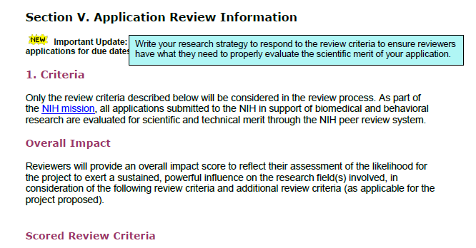
Application: Review Criteria
Each FOA specifies all review criteria and considerations that will be used in the evaluation of applications submitted for that FOA.
Your application should respond to the review criteria listed in the FOA

Slide 14
Foreign Institution Registration
Grants.gov and NIH eRA Commons
Must register prior to application submission
Data Universal Number System (DUNS)
Changing December 2020 (NOT-OD-19-098 – look for further guidance
System for Award Management (SAM) – renewed annually
NATO Commercial and Government Entity (NCAGE)
https://grants.nih.gov/grants/foreign/index.htm
If funded, must register with HHS Payment Management System
This registration must match SAM or cannot draw funds

Slide 15
Foreign Institution Registration
EIN
For applications, if your organization is not in the United States, enter 44-4444444.
DUNS
This field is required for the primary performance site.
Enter the DUNS or DUNS+4 number associated with the organization where the project will be performed.

Slide 16
Do I Contact NIH Before Applying?
Mandatory:
Application with budget >$500,000 direct costs (excluding consortium F&A) for any budget period.
Does not apply to applications submitted in response to RFAs or other announcements that include specific budgetary limits.
Optional:
When RFA’s request a Letter of Intent
Recommended when submitting any application

Slide 17
Budget Considerations
Foreign site salary norms
Procurement and availability of research supplies
Importation of drugs
Currency exchange rates
Travel, transport, visas, VAT
Face-to-face team meetings

Slide 18
F&A for Foreign Awards
Necessary costs incurred by a recipient for a common purpose benefitting more than one cost objective, and not readily assignable to specifically award.
Supports cost of compliance with federal requirements
E.g., protection of human subjects, animal welfare, invention reporting, other post-award reporting requirements, financial conflict of interest and research misconduct.

Slide 19
F&A for Foreign Awards
8 % of modified total direct costs (MTDC), exclusive of tuition and related fees, direct expenditures for equipment, and subawards in excess of $25,000.

Slide 20
Calculating F&A for Foreign Award
Total Direct Cost to Foreign Prime: $290,000
Including Equipment Cost: $9,000
Including 1 Subaward: $30,000 total cost
MTDC Calculation:
$290,000 (Total Direct Costs)
- $9,000 (Equipment)
- $5,000* (In Excess of Subaward Allowance)
= $276,000
F&A Calculation: $276,000 x 8% = $22,080
Total Cost calculation: $290,000 TDC + 22,080 (F&A) = $312,080
Subtraction Method
$30,000 (Subaward Total Costs)
- $25,000 (Subaward Allowance)
= $5,000 (In Excess of Subaward

Slide 21
Calculating F&A for Foreign Award
Direct Cost at Foreign Prime: $260,000
Including Equipment Cost: $9,000
subaward total costs $30,000 total cost
290,000
MTDC Calculation:
$260,000 (Total Direct Costs)
- $9,000 (Equipment)
+$25,000* (In Excess of Subaward Allowance)
= $276,000
F&A Calculation: $276,000 x 8% = $22,080
Total Cost calculation: $290,000 TDC + 22,080 (F&A) = $312,080
Addition Method

Slide 22
Funding Collaborations
Traditional Subcontract/Consortium
U.S. Institution is responsible
Requires a formalized written agreement
Substantial scientific involvement
Ensure the collaborating organization(s) understand the rules and regulations
Determine who has the authority to sign for the organization
Local hierarchy in foreign organization

Slide 23
Funding Collaborations
Traditional Subcontract/Consortium
Decide how and when the funds will be disbursed
Understand local reimbursement systems
Salary support for local investigators
Project delays = no salary support for staff
Check or Wire payments
Advance payments
Establish procedures for reporting progress and use of funds
U.S. awardees will flow down to foreign subrecipients applicable parts of the Uniform Guidance and monitor foreign entity progress

Slide 24
Funding Collaborations
Vendor Agreement
Routine goods and services
Ancillary to the research
Provides similar service to many
Not the same written requirements as consortium agreement
Determine payment process

Slide 25
Human Subject Research
Recipient is accountable
Federal wide Assurance (FWA) and Institutional Review Board (IRB) rules apply to international
domestic sites of multi-site studies that will conduct same protocol involving non-exempt human subjects research must use a single Institutional Review Board (sIRB)
Some countries have in-country requirements
National ethical reviews may be required

Slide 26
Human Subject Research
Revised Common Rule (45 CFR 46)
January 21, 2019, studies initiated on or after that date, ongoing studies that voluntarily transitioned to the Revised Common Rule, and studies that voluntarily implemented the three burden-reducing provisions during the delay period (7/19/18 – 1/20/19), are expected to comply with all Revised Common Rule requirements for the remainder of the study.
New Exemption Codes “X” for applications submitted on or after 1/25/19
Changes to IRB review criteria, IRBs are now required to review and approve the research protocol.
Resources:
Protection of Human Subjects
NOT-OD-19-050
Application Guide

Slide 27
Human Subject Research
NIH discontinued support of the Protecting Human Subjects Research Participants (PHRP) training.
September 26, 2018 was the last available date for the training online
Per policy, NIH does not endorse any specific program to fulfill requirements.
Responsibility of fulfilling PHRP Requirements lies with the institution.
It is up to the institution to determine what constitutes as “appropriate training.”
FAQ section is being created for the OEP website.
References: NOT OD-00-039, NOT OD-18-221, PHRP website

Slide 28
Vertebrate Animal Research
Recipient is accountable
Animal Welfare Assurance (AWA) required
Foreign site must provide domestic recipient with verification of IACUC approval
Foreign recipients provide OLAW with an Animal Welfare Assurance
IACUC approval is not required for direct foreign awards

Slide 29
Project Monitoring
Research Performance Progress Report (RPPR)
Section E.4--What dollar amount of the award’s budget is being spent in foreign country(ies)?
Domestic awardees provide dollar amount obligated to first-tier subawards to foreign entities
Foreign awardees provide dollar amount of award excluding first-tier subawards to U.S. entities
Dollars should reflect Total Costs
For multiple foreign countries, include distribution between foreign countries
Foreign travel and purchases not necessary unless part of first-tier sub

Slide 30
Project Monitoring
Research Performance Progress Report (RPPR)
Section G.9 Foreign Component—Provide information on foreign components
Significant scientific activity performed outside of the U.S. whether or not grant funds were expended
NIAID adds a Term of Award to NoA to remind Grantees that research conducted outside the Unites States needs to be reported
D.1 – Participants
Check “yes” and add the organization/country if the individual’s primary affiliation is foreign and working in a foreign country

Slide 31
Tips for Foreign Investigators
NIH Grants Policy Statement (GPS) section 7.9.1 provides a subset of common, allowable costs. The list is not all inclusive.
NIH GPS Section 16.6 provides unallowable costs and grant requirements for foreign grantees and foreign components.
Unallowable Costs
Major alterations and renovations (A&R). Costs for major A&R (>$500,000).
Patient Care Costs are provided only in exceptional circumstances.
Grantees are reminded that they may not invest grant funds to defray the cost of inflation.

Slide 32
Tips for Foreign Investigators
Don’t forget about the Audit Requirements – required if expended $750,000 or more in HHS awards.

Slide 33
Select Agent Requirements
Awardees who conduct research involving select agents must provide information satisfactory to the NIH that a process equivalent to that described in 42 CFR 73 for US institutions is in place and will be administered on behalf of all select agent work sponsored by NIH funds before using these funds for any work directly involving select agents.

Slide 34
Select Agent Requirements
Recipient must address key elements to NIH prior to use of funds.
Safety
Security
Training
Procedures for ensuring only approved/appropriate individuals have access to the select agent
Any applicable local laws equivalent to 42 CFR 73

Slide 35
Prior Approval
Change in Scope
Change of PD/PI
Carryover of unobligated balances – required if NoA includes a term and condition of award
Change or addition of a performance site within a foreign country

Slide 36
Prior Approval
Transfer of a grant from foreign organization to domestic organization
Transfer of a grant to or between foreign or international organizations
Requires approval of the NIH and National Advisory Council or Board.
Contact NIH Program Officer/Grants Management Specialist for prior approvals

Slide 37
Project Monitoring
Monitoring Budget
Time and effort reporting insufficient
Applying 8% F&A
Must maintain grant funds in an interest-bearing account; however, interest earned in excess of $500 per year in the aggregate on advances of Federal funds must be returned.

Slide 38
Don’t Forget Closeout
Documents are due within 120 calendar days of the end of grant support:
Final Federal Financial Report (FFR) SF-425 Expenditure Data (submitted through eRA Commons);
Grantees must ensure there are no discrepancies between final FFR expenditure data and Payment Management System.
Reconcile award and expenditures
Review carefully for restricted funds or carryovers
Final Invention Statement & Certification;
Final RPPR (F-RPPR) and Interim-RPPR

Slide 39
Key Take-Aways
Review the Notice of Award (NoA) for funding information and to determine:
Streamlined Noncompeting Award Process (SNAP) vs. non-SNAP
Automatic carryover authority
Federal Financial Report (FFR)
For non-SNAP awards - required annually
For SNAP awards - required at end of the competitive segment

Slide 40
Key Take-Aways
Consult NIH Grants Policy Statement for policies and compliance requirements
Have SOPs
Follow four cost principles:
Reasonableness – The dollar amount is within the limitations that a prudent person would pay for the good or service.
Allocability – The goods or services that can be assigned directly to the grant.
Consistency – Routinely applied to the same category.
Conformance – Test of allowability. Grants costs
must conform to the “Allowability of costs/Activities” section of the NIH Grants Policy Statement.

Slide 41
Key Take-Aways
Communication
Most foreign institutions need assistance in understanding NIH requirements
Understand their unique policies, regulations and practices
Be involved for the long term
Be patient

Slide 42
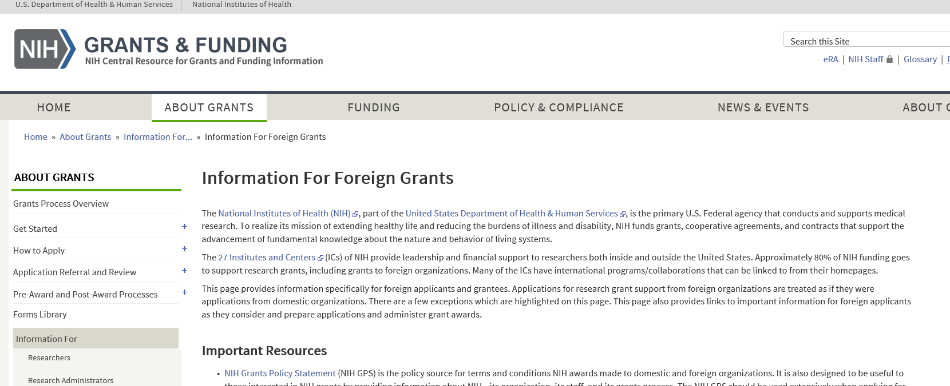
Information for Foreign Grants
https://grants.nih.gov/grants/foreign/index.htm

Slide 43
THANK YOU!
Emily Linde
lindee@mail.nih.gov

